Slide 1
CSE4204 LAB-5 : Intro to Three.js

Slide 2
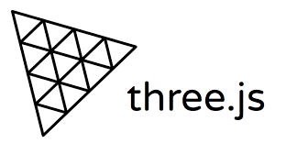
What is three.js?
A javascript library
You can create and display 3D graphics on web browser
Built on WebGL API
Easy to use
https://threejs.org

Slide 3
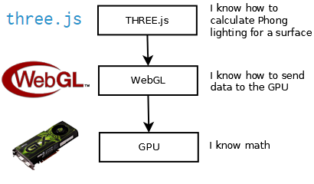
three.js
Source: https://cglearn.codelight.eu/pub/computer-graphics/computer-graphics

Slide 4
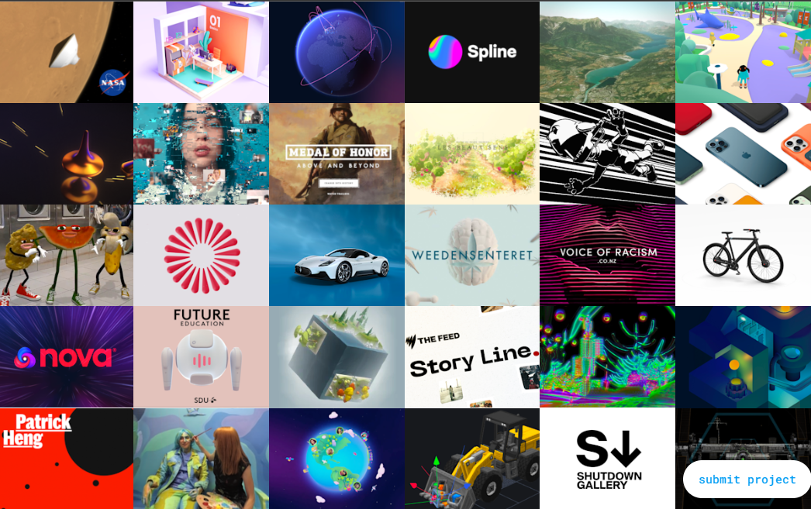
What you can do with three.js
Source: https://threejs.org/

Slide 5
Installation
three.js can be installed with npm
or can be used with static hosting or a CDN
npm is the most common approach

Slide 6
Installation with npm
Download and install the latest version of Node.js
Open a terminal window in your project folder and run:
Package will be downloaded and installed
Full download will give so many additional files
You can only use the Three.js source
npm install three

Slide 7
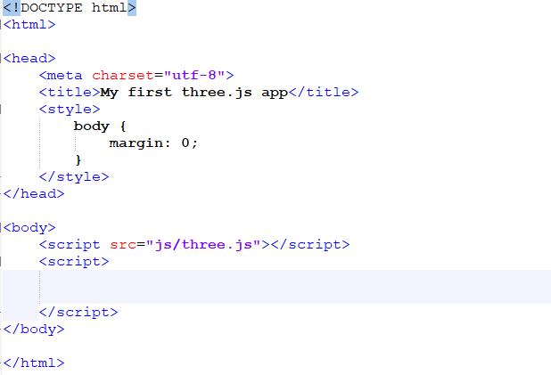
Basic Setup: Adding the library file

Slide 8
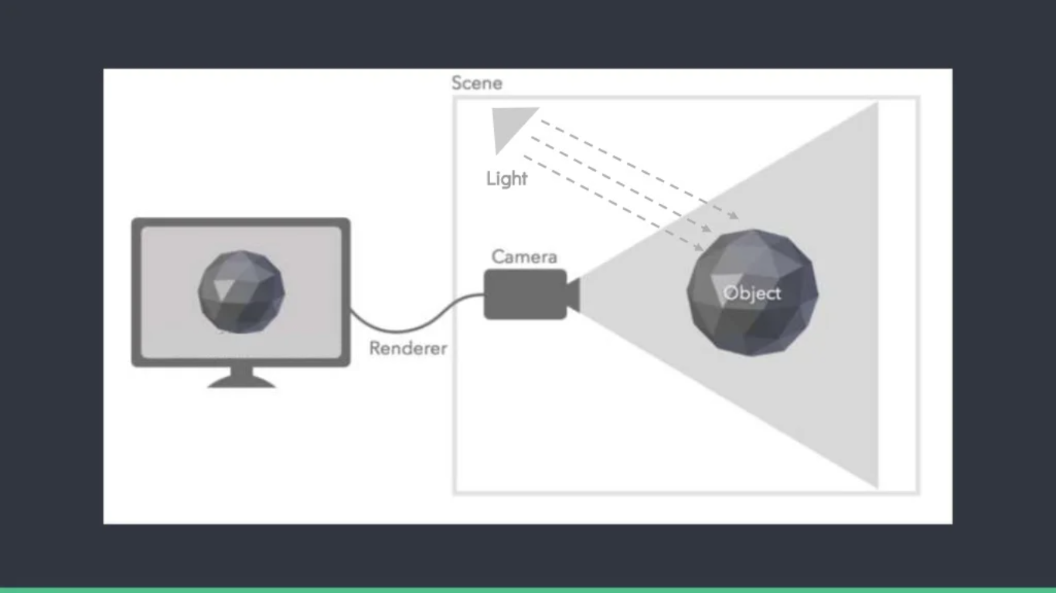
Basic Elements of Three.js

Slide 9
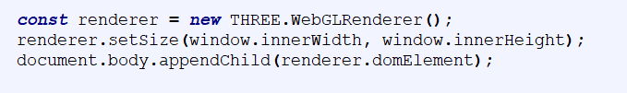

Basic Elements: Renderer
Renderer draws the scene
Needs to be attached to an HTML element
Create a WebGLRenderer
II. Beautify it

Slide 10

Output!

Slide 11
Basic Elements: Camera
Camera is the view port to look at the objects in a scene
Camera controls how your object will be seen
2 main types of camera: Orthographic and Perspective
III. Creating a Camera

Slide 12
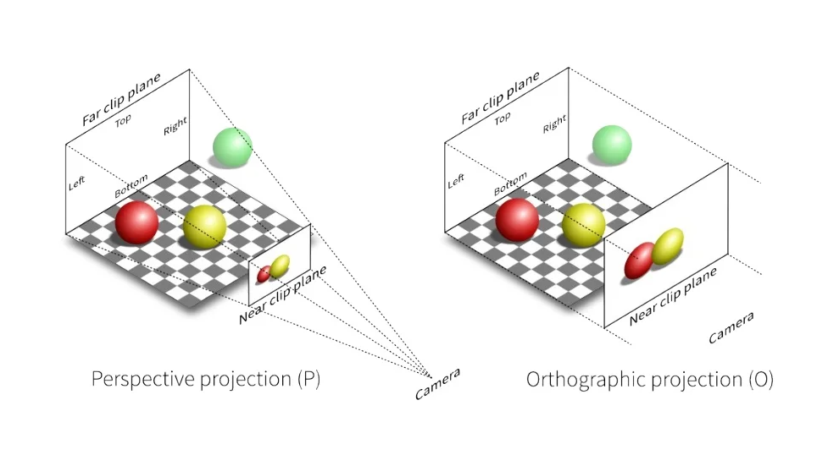
Basic Elements: Camera
Source: https://www.slideshare.net/GarethMarland/introduction-tothreejs

Slide 13

Basic Elements: Scene
Scene is where you put your modes, such as car, house or cubes
IV. Create a Scene
V. Render the scene from the camera

Slide 14
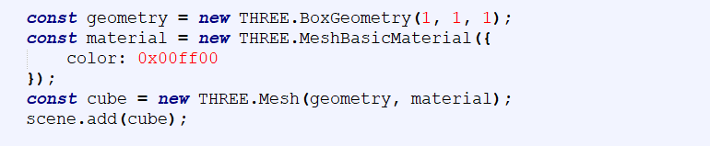
Basic Elements: Geometry (Objects)
three.js provides some predefined geometry
You can define your own vertices
Use an existing model
VI. Create a mesh with geometry and add it to the scene

Slide 15
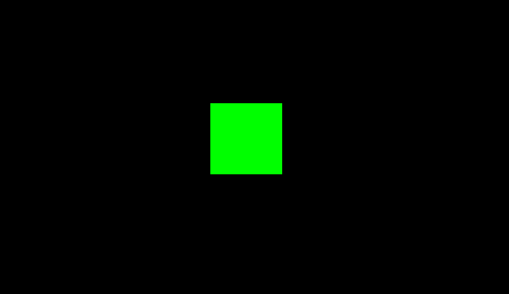
cube.html

Slide 16
Recap
Create a Renderer
new THREE.WebGLRenderer()
Create a camera
new THREE.PerspectiveCamera(FOV, viewAspectRatio, zNear, zFar)
Create a Scene
new THREE.Scene()
Render the scene from the camera
renderer(scene, camera)
Create a mesh with geometry and add it to the scene
const cube = new THREE.Mesh(geometry, material);
scene.add(cube);

Slide 17
Lighting
Light globally illuminates the objects
three.js provides some lighting models
Common lighting model: Ambient Light, Point Light, Directional Light

Slide 18
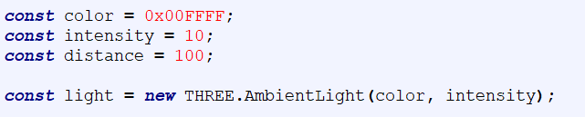
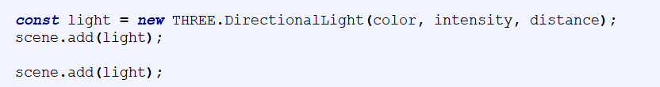
Lighting
Just create the light and add it to the scene
Ambient Light
Point Light
Directional Light

Slide 19
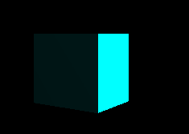
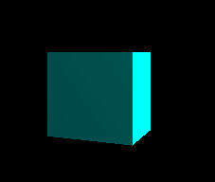

lighting.html
Ambient Light
Point Light
Directional Light

Slide 20
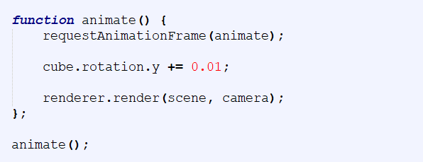
Animation
requestAnimationFrame creates a loop
It causes renderer to draw a new scene
Generally refresh rate is 60FPS

Slide 21
cubeRotation.html

Slide 22
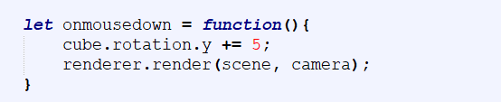
User Interaction
User interaction can be done with mouse clicking or moving or pressing a key on the keyboard
Create the action method and add it to the event listener

Slide 23
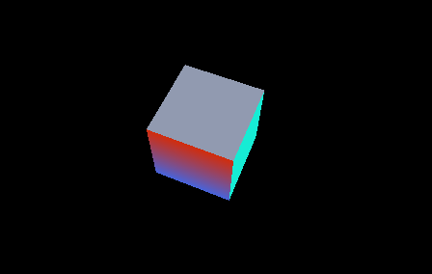
mouseClick.html

Slide 24
Texture Mapping
We can give realistic appearance to our objects by applying texture mapping
A texture is an image that would wrap the object
In order to apply texture mapping, we need to load the texture
Texture is loaded as a texture object

Slide 25
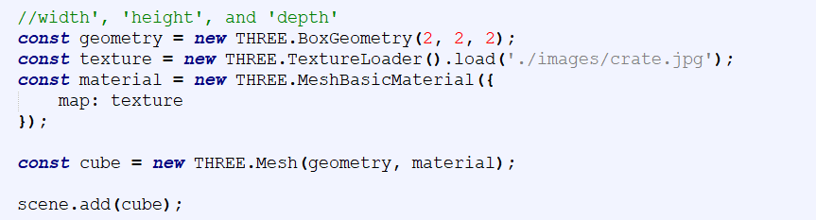
Texture Mapping
Load the texture object and map it onto the object

Slide 26
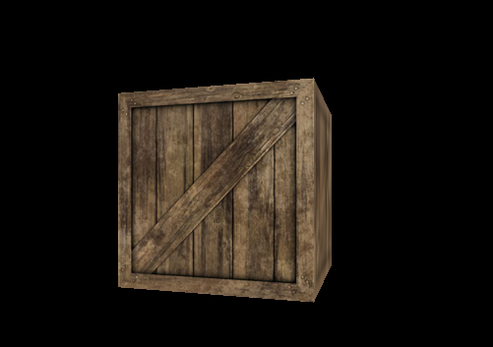
texture.html

